Slide 1
Sub. Code: UIT1401 Title: Principles of Software Engineering
Prepared By: Dr.V.Arulkumar, Asst.Prof, IT

Slide 2
Course objectives
● To understand the process and its models.
● To understand fundamental concepts of requirements engineering and Analysis Modeling.
● To understand the major considerations for enterprise integration and deployment.
● To learn various testing and maintenance measures.

Slide 3
Course outcome
At the end of the course, the student should be able to
● Identify the key phases in process models.
● Compare different process models.
● Apply the concepts of requirements engineering and Analysis modelling.
● Apply systematic procedure for software design and deployment.
● Compare and contrast various testing and maintenance.

Slide 4
Unit outcomes
SOFTWARE TESTING
Risk Management – Identification, Projection, RMMM - Software Configuration Management: Definitions and terminology, processes and activities, Configuration audit – Software Quality Assurance: Quality Definition, Quality of Conformance, Cost and benefits of quality, Quality control and Quality assurance.
After discussing this chapter, students will able to know the following:
Able to know the Risk Management, Identification.
Able to know the Software Configuration Management.
Able to know the Software Quality Assurance.
Able to identify Quality control and Quality assurance.

Slide 5
SCM
SCM: AN OVERVIEW

Slide 6
Agenda
Introduction
Concepts
CBSD

Slide 7
Agenda
Introduction
Concepts
CBSD

Slide 8
Introduction
Configuration management: the art of coordinating software development to minimize confusion
Configuration management is the art of identifying, organizing, and controlling modifications to the software being built
The goal is to maximize productivity by minimizing mistakes

Slide 9
Introduction
SCM is an umbrella activity that is applied throughout the software process
All information produced as part of the software process are collectively called a software configuration

Slide 10
Introduction
First Law of System Engineering states: No matter where you are in the system life cycle, the system will change, and the desire to change it will persist throughout the life cycle

Slide 11
Introduction
Fundamental sources of change:
New business or market conditions
New customer needs
Reorganization and/or business downsizing
Budgetary or scheduling

Slide 12
Agenda
Introduction
Concepts
CBSD

Slide 13
Concepts
Baseline, IEEE defines a baseline as:
A specification or product that has been formally reviewed and agreed upon, that thereafter serves as the basis for further development, and that can be changed only through formal change control procedures

Slide 14
Common Baselines
System engineering
Requirement analysis
Software design
Coding
Testing
Release
System specification
Software requirement specification
Design specification
Source code
Test plans/Procedures/Data
Operational system

Slide 15
Software Configuration Item (SCI)
Information created as part of SE process
SCIs used as target in SCM:
System specification
Software project plan
Software requirements specification
Preliminary user manual
Design specification
Source code listing

Slide 16
Software Configuration Item (SCI)
Test specification
Operation and installation manuals
Executable program
Database description
As-built user manual
Maintenance documents
Standards and procedures for SE

Slide 17
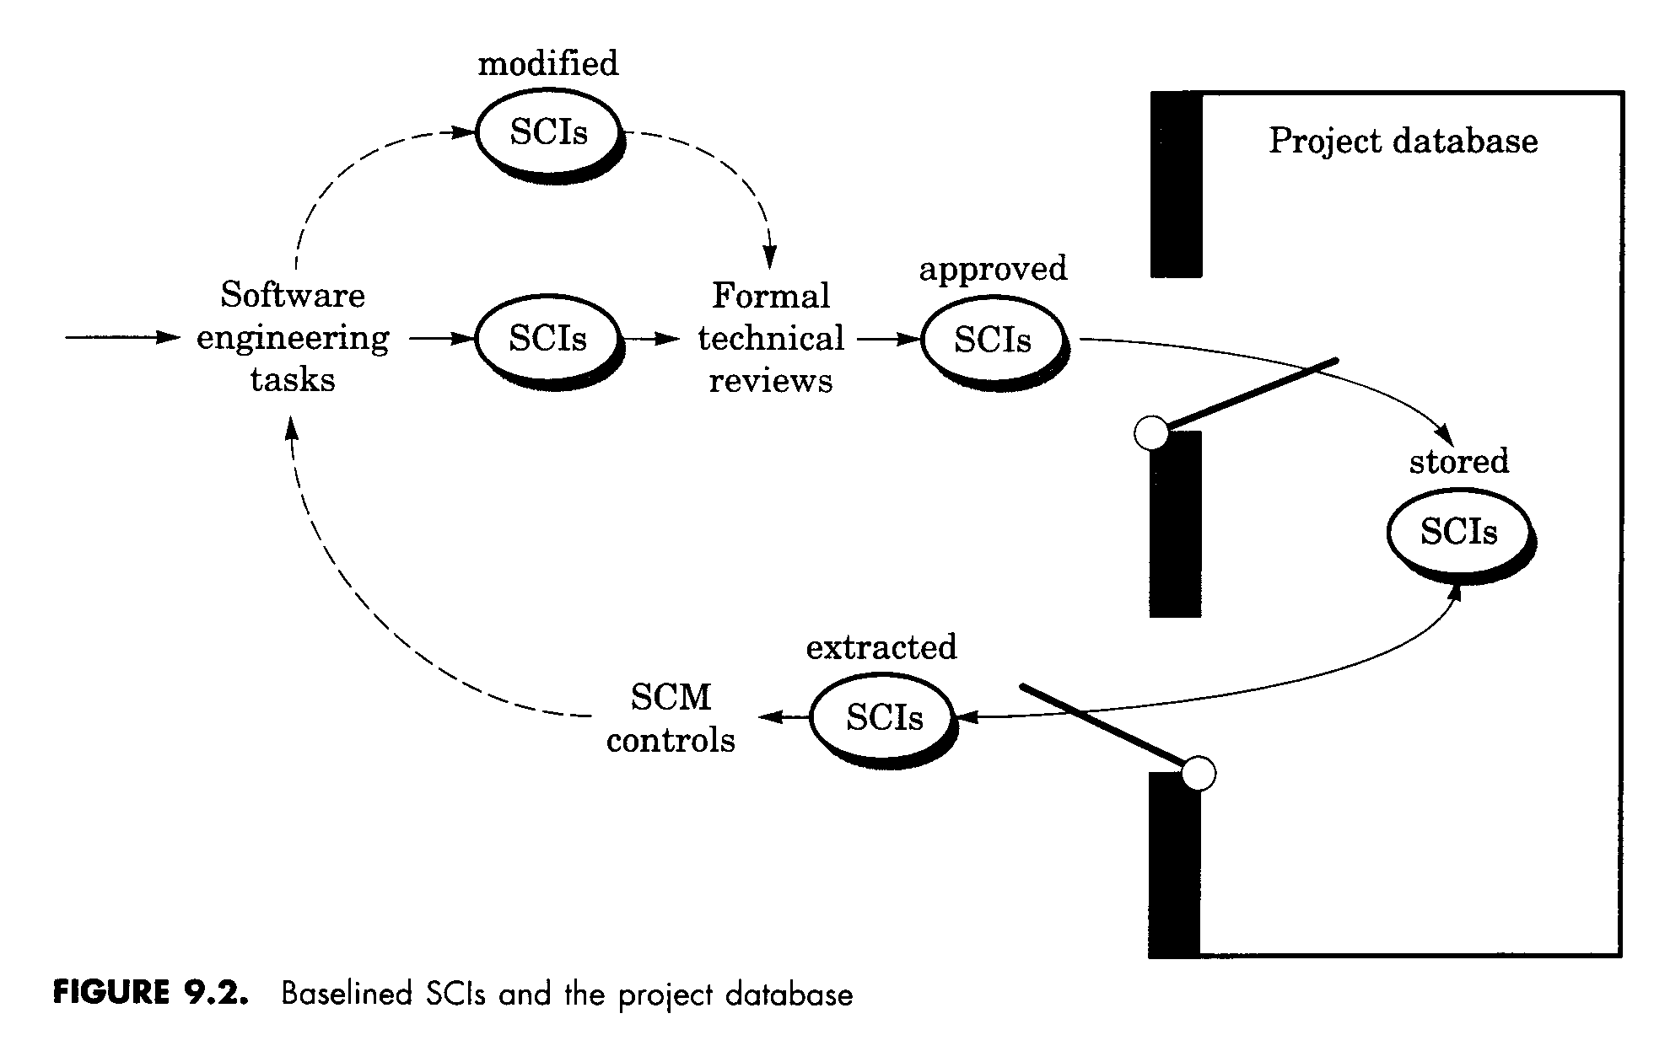
SCI Modification Process
[Pressman, 1997]

Slide 18
Object identification in SW configuration
SCI can be named and organized using OO approach
Two types of objects:
basic object: ‘unit of text’ created during analysis, design, coding, or testing.
Aggregated objects: a collect of basic objects

Slide 19
Object identification in SW configuration
Features of objects:
name: a character string
description: a list of data items to identify the SCI type and a project id, version information, etc.
resources: entity that are provided, processed, referenced by the object
Realization: a pointer to ‘unit of text’ for a basic object or null for an aggregate object

Slide 20
Object identification in SW configuration
Relationships between objects
part-of: a hierarchical relationship
interrelated: a cross-structural relationship
Object identification methods
evolution graph
automated SCM tools
module interconnection language

Slide 21
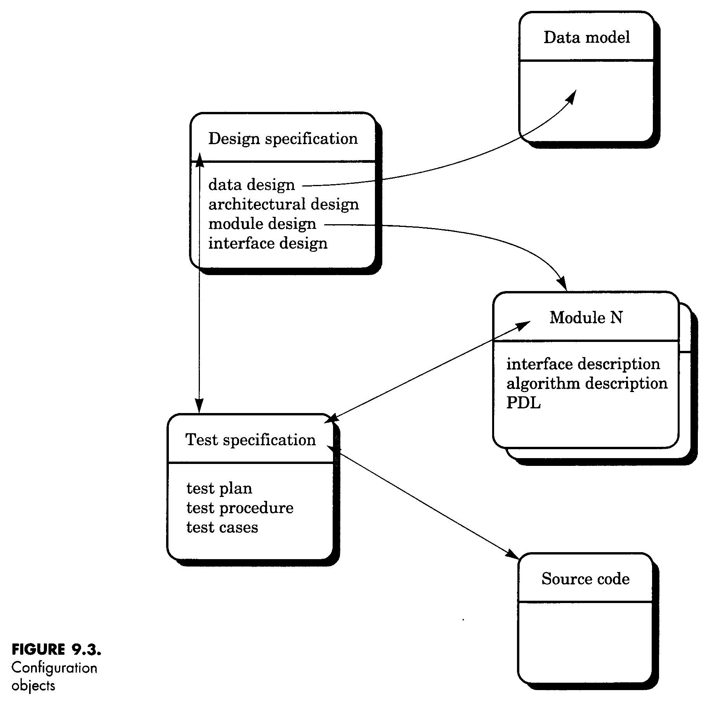
Configuration Objects
[Pressman, 1997]

Slide 22
SCM Process
Identification
Version control
Change control
Configuration auditing
Status reporting

Slide 23
Configuration Control
Enforces a rigorous change control mechanism
Requires formal procedures to
request changes
carry out impact analysis
approve changes
carry out changes

Slide 24
Evolution Graph
obj
1.3
obj
1.4
obj
1.0
obj
1.1
obj
1.2
obj
2.0
obj
2.1
obj
1.1.1
obj
1.1.2
[Pressman, 1997]

Slide 25
Merging
Two diverging versions may be merged to create a single new version combining both set of change requests.
Merge operations are typically done interactively with tool assistance

Slide 26
Version Control
Some of the issues
When an executable is built, the versions of its constituents must be consistent.
If A depends upon B and B is recompiled, A may also need to be recompiled.
What if multiple people need to modify same SCI?
Need to know what version different customers have
How do you keep track of 100’s or 1000’s of modules?

Slide 27
Version Control
Evolution graph to represent different versions
Uses an object pool representing components, variants and versions, and their relationship
RCS (Revision Control System) is common tool.
Use for documentation as well as code development
[Conradi, 1998]

Slide 28
Techniques for storing Versions
Full files
Forward Delta files
Reverse Delta files
The set of differences between two versions is called a delta.
[Conradi, 1998]

Slide 29
Version Control Support
At the language level (in Ada):
If only body of B changes, no change to A
If spec of B changes, A must be recompiled
With B;
Spec A
Body A
Spec B
Body B

Slide 30
Change Control
Change request from user
Developer evaluates
Change report is generated
Change control authority makes decision
Request is queued, persons are assigned
“Check out” SCI(s)
Change request is denied
User is informed

Slide 31
Change Control
Make the change/review change
‘Check in’ changed SCIs
Establish a baseline for testing
Do SQA and ‘promote’ changes for inclusion in next release
Rebuild appropriate version
Audit the SCI changes/ include changes in new version
Release the new version

Slide 32
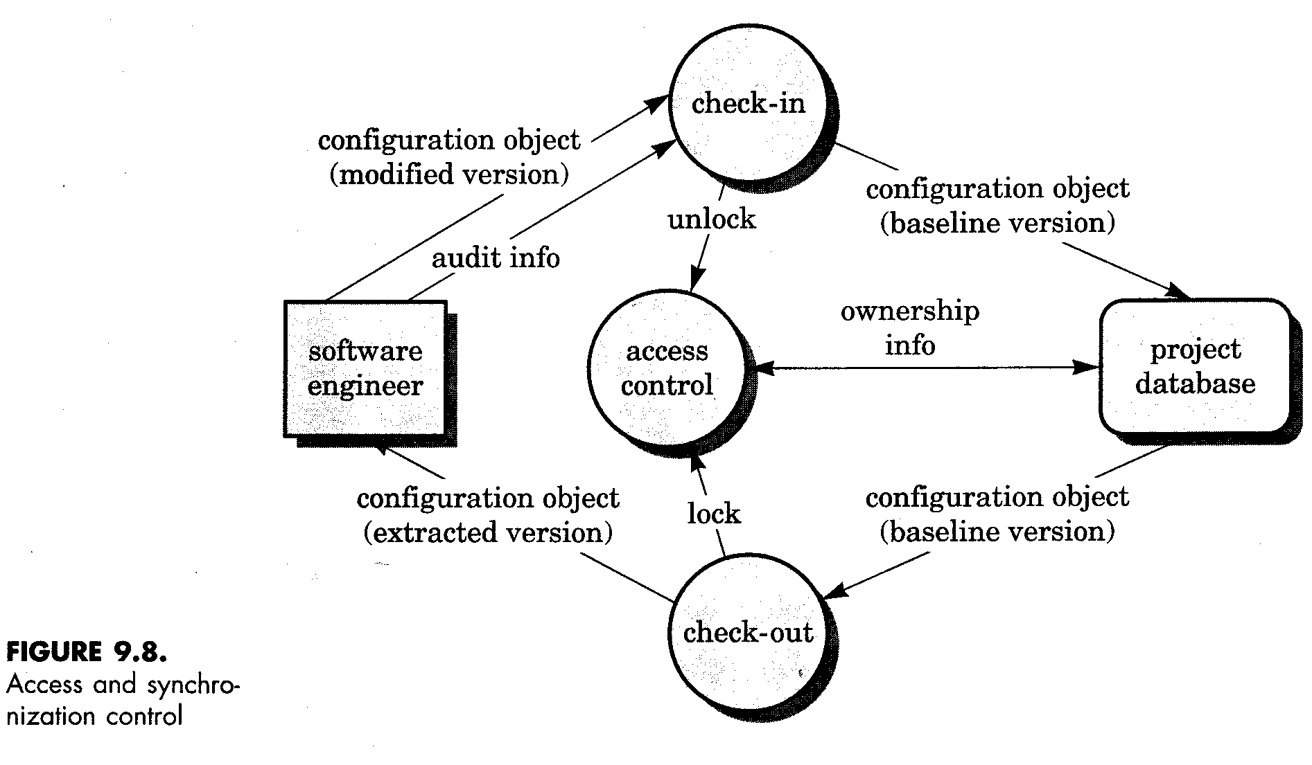
Access and Synchronization Control
[Pressman, 1997]

Slide 33
Configuration Audit
Two approaches can be used to ensure proper implementation of change:
formal technical review (FTR)
software configuration audit
CA assesses a configuration object for characteristics that are not generally not considered during review
CA generally checks:
Changes incorporated
FTR conducted
SE standards followed
SCM procedures followed
all related SCIs properly updated
change date and author specified

Slide 34
Status Reporting
Event occurred -- An SCI received updated ID
people involved
Time happened
Effects on others
Generated on a regular basis
To improve communication among all parties

Slide 35
Organising for SCM
Roles:
Configuration manager
Change Control Board
includes representatives of
- user
- customer
- developer

Slide 36
SCM Planning
The SCM Plan is prepared in Project Initiation phase. It documents
- what SCM activities are to be done
- how they are to be done
- who is responsible for doing specific
activities
- when they are to happen
- what resources are required

Slide 37
SCM Planning
The outcome of the SCM planning phase is the Software Configuration Management Plan (SCMP), which might be extended or revised during the rest of the project.
The SCMP can either follow a public standard like the IEEE 828, or an internal (e.g. company specific) standard.

Slide 38
SCM Tools
Common features of popular PC-based tools (PVCS, MS Visual SourceSafe):
Support for controlling all types of files (source code as well as binary)
Managing changes as deltas
Supporting branching and merging
Identifying and re-creating releases
Providing a project view

Slide 39
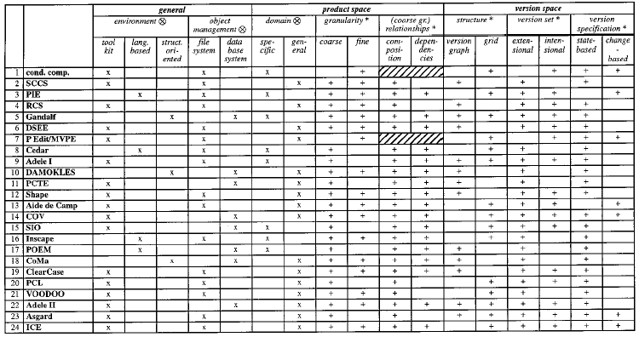
SCM Tools
[Conradi, 1998]

Slide 40
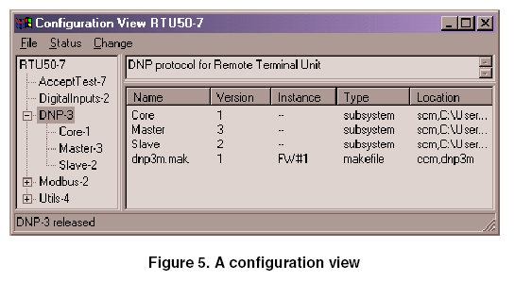
Research Tools
[Volzer, 2002]

Slide 41
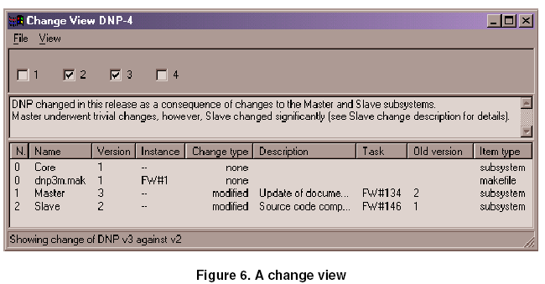
Research Tools
[Volzer, 2002]

Slide 42
Outline of a Software Configuration Management Plan (SCMP, IEEE 828-1990)
1. Introduction
Describes purpose, scope of application, key terms and references
2. Management (Who?)
Identifies the responsibilities and authorities for accomplishing the planned configuration management activities
3. Activities (What?)
Identifies the activities to be performed in applying to the project.

Slide 43
Outline of a Software Configuration Management Plan (SCMP, IEEE 828-1990)
4. Schedule (When?)
Establishes the sequence and coordination of the SCM activities with project mile stones.
5. Resources (How?)
Identifies tools and techniques required for the implementation of the SCMP
6. Maintenance
Identifies activities and responsibilities on how the SCMP will be kept current during the life-cycle of the project.

Slide 44
Tailoring the SCMP
The IEEE standard allows quite a bit of flexibility for preparing an SCMP.
To conform to the rest of the project, the SCMP may be
tailored upward:
to add information
to use a specific format
tailored downward:
Some SCMP components might not apply to a particular project.
Instead of omitting the associated section, mention its applicability.
Information that has not been decided on at the time the SCMP is approved should be marked as “to be determined”.

Slide 45
Conformance to the IEEE Standard 828-1990
Presentation format & minimum information:
A separate document or a section embedded in another document titled “Software Configuration Management Plan”.
6 sections: Introduction, Management, Activities, Schedules, Resources and Plan Maintenance

Slide 46
Conformance to the IEEE Standard 828-1990
Consistency Criteria:
All activities defined in the SCMP are assigned to an organizational unit or person and they are associated with resources to accomplish the activities.
All identified configuration items have defined processes for baseline establishment and change control.

Slide 47
Agenda
Introduction
Concepts
CBSD

Slide 48
CBSD
Like the traditional way to develop software, CBSD also needs the support of SCM
CBSD brings new challenges to SCM
[Mei, 2001]

Slide 49
CBSD
Some identified issues:
In CBSD, usually an application is implemented into many many files
A file is not a logical constituent in an CBSD application
Software architecture has been viewed as an important milestone in the lifecycle of software
[Mei, 2001]

Slide 50
CBSD
Difficults in CBSD to be solved by SCM
Any change to a component must consider all products that use this component– Often, each change leads to a new version, rather than the modification of an existing asset

Slide 51
CBSD
According to [Mei, 2001], using files as the primitive items and asking developers to operate on the files directly are not an efficient way to support CBSD

Slide 52
CBSD
To support CBSD, SCM should solve the following issues:
Viewing each component as an entity and operating on components
Controlling the current modifications to each component
Managing component composition and relationships between/among components

Slide 53
New trends
Formal models
Distinction between physical unit and logical unit
Two types of logical units: Primitive components and composite components
Some works for helping to extract information from SCM systems like information related to potential impact of a change, decision support [Sahraoui, 2000]

Slide 54
New trends
Works trying to measure changes impacts in the system as whole and to track every fault to a system element [Nikora, 2003]

Slide 55
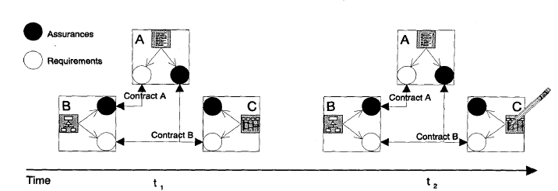
Requirements/Assurances Contracts
[Rausch, 2000]

Slide 56
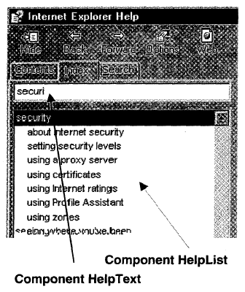
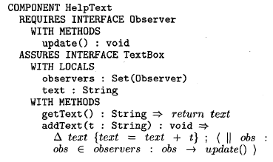
Requirements/Assurances Contracts
[Rausch, 2000]

Slide 57
Conclusions
Components evolves so that it must be monitored/managed
SCM has to work with logical unit that be suitable to CBSD development
SCM has to have models to represent all kind of important relations between/among components

Slide 58
Conclusions
The SCM models must take into account how to reasoning about system properties and make predictions or forecastings
The SCM tools are going to work at the syntactical, semantic, and architectural levels

Slide 59
References
[Conradi, 1998] R. Conradi, B. Westfechtel, Version Models for Software Configuration Management, ACM Computing Surveys, Vol. 30, No. 2, June 1998.
[Nikora, 2003] A. L. Nikora, et al., Understanding the Nature of Software Evolution, ICSM Proceeding, 2003.
[Kilpi, 1997]T. Kilpi, New Challenges for Version Control and Configuration Management: a Framework and Evaluation, IEEE, 1997.
[Sousa, 1998] M. J. C. Sousa, et al., A Survey of the Software Maintenance Process, IEEE, 1998.
[Sahraoui, 2000] H. A. Sahraoui, et al., Toward the Automatic Assessment of Evolvability for Reusable Class Libraries, IEEE, 2000.

Slide 60
References
[Bereton, 1999] P. Bereton, Evolution of Component Based Systems, March, 1999.
[Akkanen, 2002] J. Akkanen, et al., Evolution of Software Component – Experience with a Network Editor Component, CSMR Proceedings, 2002.
[Volzer, 2002] H. Volzer, A Tool for Subsystem Configuration Management, ICSM Proceedings, 2002.
[Murta, 2004] L. Murta, ODYSSEY-SCM: UMA ABORDAGEM DE GEREÊNCIA DE CONFIGURAÇÃO DE SOFTWARE PARA O DESENVOLVIMENTO BASEADO EM COMPONENTES, Exame de Qualificação de Doutorado, COPPE, UFRJ, Rio de Janeiro, Brasil, 2004.

Slide 61
reference
Roger S. Pressman, Software Engineering – A practitioner’s Approach, Seventh Edition, McGraw-Hill International Edition, 2010.
Ian Sommerville, Software Engineering, 9th Edition, Pearson Education Asia, 2011.

